Slide 1


A Quick Introduction to LincSys, Ver 1.0: A Hydraulic Simulation Model for Linear-Move and Center-Pivot Irrigation Systems
D. Zerihun and C.A. Sanchez
University of Arizona
Maricopa Agricultural Center
Maricopa, AZ

Slide 2
Outline
  Overview
  Linear-move and center-pivot irrigation systems
  Installation of LincSys
  Running LincSys
  Systems-Projects window
    Features, layout, and functionalities
  Input window
    Features, layout, and functionalities
  Output window
    Features, layout, and functionalities
  Charts window
    Features, layout, and functionalities
Quick exploration of the installation folder
Outline

Slide 3
Linear-move and center-pivot irrigation systems
Before proceeding with the presentation of the LincSys software, we will
quickly touch on the importance, features, and components of
linear-move and center-pivot irrigation systems
Center-pivots and linear-moves

Slide 4
Linear-move and center-pivot irrigation systems
  Importance and advantages
    Collectively, linear-moves and center-pivots are the most widely used irrigation methods
    in the United States
    Expanding in other parts of the world
    High performance: application efficiency > 80% and uniformity > 0.85 ^{(*)}
    Suitable for site specific application of water and chemicals and have minimal labor
    requirements. Mainly, because of their amenability to automation
^{(*)} Keller, J., Corey, F., Walker, W.R., and Vavra, M.E. (1980)
Importance

Slide 5
Linear-move and center-pivot systems
  System description
    A linear-move or center-pivot irrigation system is a
    self-propelled machine consisting of a lateral that
    apply irrigation as it moves across the irrigated field
    Linear-moves travel in a straight line path irrigating a rectangular field (Figure a)
    Center-pivots rotate about a fixed pivot point and irrigate
    a circular area (Figure b)
Figure (a) Sketch of a linear-move system obtaining its water supply form a canal
and (b) Details showing a support tower, drop-tube fitted with a prv-emitter
assembly, and drive unit (from section at α-α, Figure a and c), and (c) Sketch of a
center-pivot system
System description

Slide 6
Linear-move and center-pivot systems
  System components
    The lateral is placed at a suitable above ground clearance atop an elevated platform, consisting of
    Structural elements (trusses, cables, and support towers on wheels)
    Drive units and
    Alignment mechanism
    that support and propel the system as well as keep it
    aligned
    Linear-moves also have
    A separate guidance mechanism that keeps the lateral
    on a preset straight line course
    Figure a also displays the power unit and intake apparatus attached to the inlet end of the linear move lateral
Figure (a) Sketch of a linear-move system obtaining its water supply form a canal
and (b) Details showing a support tower, drop-tube fitted with a prv-emitter
assembly, and drive unit (from section at α-α, Figure a and c), and (c) Sketch of a
center-pivot system
System components

Slide 7
Linear-move and center-pivot systems
  System components ….
    These machines typically use closely spaced precision applicators (consisting of low-pressure spray nozzles coupled to droptubes and pressure regulators) to meter outlet discharges along the lateral (Figure b)
      Advantages of precision applicators as emission devices are
    Higher irrigation application efficiencies
    and uniformities
      A more uniform application of agricultural
      chemicals
      Reduced energy consumption
Figure (a) Sketch of a linear-move system obtaining its water supply form a canal
and (b) Details showing a support tower, drop-tube fitted wit\ a prv-emitter
assembly, and drive unit (from section at α-α, Figure a and c), and (c) Sketch of a
center-pivot system
System components

Slide 8

Soil moisture redistribution
The irrigation process
Precipitation
LincSys’ capability is limited to the simulation of
system hydraulics
Z
Irrigation performance
Z,I
I
0
t
Infiltration
Process

Slide 9
LincSys, an overview
  LincSys is a hydraulic simulation model for linear-move and center-pivot
  irrigation systems
  “LincSys”?
    A mnemonic for “Linear-move and Center-pivot Systems” ^{(*)}
  The LincSys software is comprised of a pair of executable files ^{(*)}
    A graphical user interface (GUI): LincSys.exe and
    A hydraulic simulation module: HydrSimLaterals.exe
^{(*)} Sections 1.1.1 to 1.1.3 of the user manual
Overview

Slide 10
Overview
The GUI consists of a tabbed form with four windows ^{(*)}
    Systems-Projects
    Input
    Output and
The user interface was developed with the basic
programming language in the MS Visual Studio Integrated
Development Environment (MS 2019) and is based on
the Windows Forms for .Net Framework Ver. 4.8
Each tabpage (window) is
designed to provide access to a set
of program functionalities
    Charts tabpages
The hydraulic simulation module ^{(*)}
    A standalone numerical model that solves the continuity and energy balance equations for
    one-dimensional steady flow in pipes
The hydraulic module was developed with a C++ programming
language in the MS Visual Studio Environment (MS 2017)
    Computes the lateral-wide distribution of emitter discharges and nodal heads along with an array
    of additional output parameters
^{(*)} Chapters 1 and 4 of the user manual
Modules of LincSys

Slide 11
Overview
Program and data flow chart

Slide 12
LincSys, an overview
  LincSys can simulate the hydraulics of laterals with three different outlet
  discharge metering configurations
    The Droptube-Prv-Emitter system configuration option: in which droptube, pressure regulator, and emitter assemblies are used as emission devices
Note : A prv is a pressure regulator that is designed to reduce
inlet pressure to a preset outlet pressure, provided the
inlet pressure is within a manufacturer recommended
range
System configuration options

Slide 13
LincSys, an overview
  LincSys can simulate the hydraulics of laterals with three different outlet
  discharge metering configurations
    The Droptube-Prv-Emitter system configuration option: in which droptube, pressure regulator, and emitter assemblies are used as emission devices
    The Droptube-Emitter configuration option: where droptubes directly coupled to emitters are used to meter outlet discharges
    The Emitter-On-Lateral system configuration option: in which emitters are
    placed directly on lateral outlets
System configuration options

Slide 14
LincSys, an overview
  Advantages of LincSys compared to earlier center-pivot and linear-move
  hydraulic models are
    LincSys takes into account the effects of
Span geometry and
Key system components (namely, pressure regulators and droptubes)
    on lateral hydraulics
    LincSys has sufficient flexibility to accommodate variabilities in lateral hydraulic and geometric parameters and field slopes
Advantages of LincSys

Slide 15
Installation of LincSys
It is unlikely that hardware constraints
would present a limitation to running
LincSys in most PCs!
System (hardware and software) requirements ^{(*)}
Hardware requirements
    CPU, memory, and graphics hardware requirements of LincSys are basic
    At installation LincSys may require approximately 120Mb storage space
Software requirements
  LincSys 1.0 can be run on machines with Windows 7.0 or later releases of the
  Windows operating system
  Necessary MS Visual Studio .Net Framework utilities are installed along with the
  core executable files of LincSys, thus the model has no requirements for additional
  software accessories
^{(*)} Section 1.2.3.a of the user manual
Hardware and software requirements

Slide 16
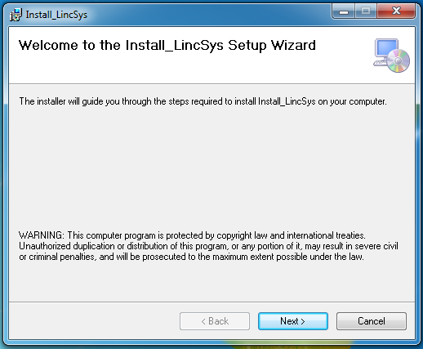
Installation
Pre-installation steps
Create the installation folder in the hard drive of your PC
  For example, let us name the installation folder “LincSys”
  Assume the folder “LincSys” is created under the “C:\Programs\” directory path
Installation steps
    Go to the LincSys installation webpage: url to be inserted here
    To start installing LincSys 1.0 in your PC click on the link: Install_LincSys
      This will start the Windows installer package (Install_LincSys)
      and opens the “Install_LincSys set up wizard” dialog box
Click on the Next button of the dialog box
To open the “Select Installation Folder” dialog box
Pre-installation and installation steps

Slide 17
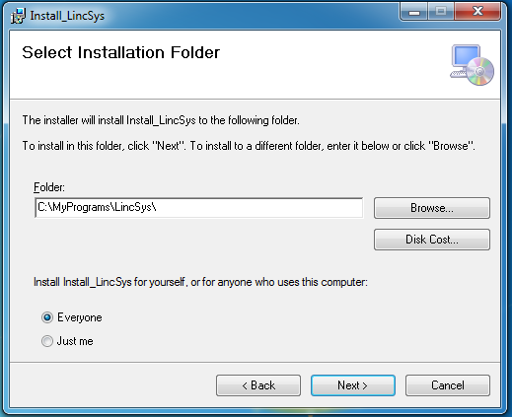
Installation
To specify the installation path in the “Select Installation Folder” dialog box
  Click on the Browse… button and select the directory path where the LincSys software package is to be placed (Note: the currently selected directory path is “C:\Programs\LincSys”)
  Use the radio button controls to specify whether the software is to be used only by yourself or anyone who uses your PC
Click on the Next button of the dialog box
  To open the “Confirm Installation” dialog box
Installation folder

Slide 18
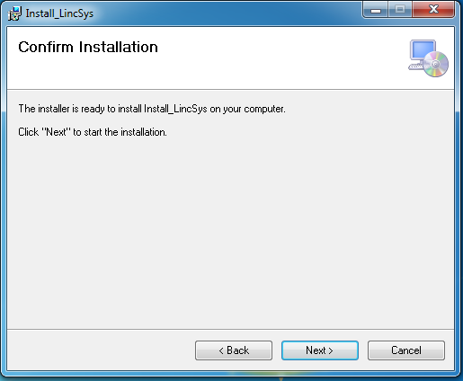
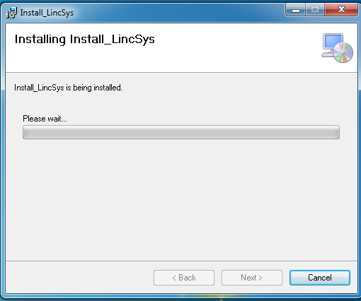
Installation
  Press the Next button to confirm installation
    Installation starts and the dialog box that displays the progress of installation will come into view
Confirm, start installation

Slide 19
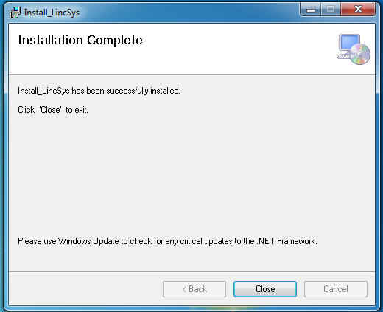
Installation
Installation complete?
  Upon successful completion of installation, the “Installation Complete” dialog box automatically appears on the screen
  LincSys is successfully installed in your PC
  Click on the Close button to exit the Installation wizard
Installation complete

Slide 20
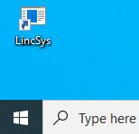

Running LincSys
Following installation, LincSys’ icon appears in:
The Windows desktop of your PC
And the Windows start menu
Windows Desktop
  To start LincSys
  Double click on LincSys icon in the Windows desktop, Or
  Click on the icon in the Windows start menu
  The user interface of LincSys (a tabbed form) with the Systems-Projects tabpage enabled
  will be opened
Windows Start Menu
Running LincSys

Slide 21
Systems-Projects tabpage
Features, layout, and functionalities of
the Systems-Projects tabpage ^{(*)}
The Systems-Projects tabpage is displayed with the Systems-Projects tabcontrol highlighted
It features a titlebar at the top of the window
The main body of the Systems-Projects window contains user interface controls that allow the selection of a system configuration option and a LincSys project. It also contains the primary access control buttons to the other tabpages
It displays a statusbar at the bottom of the window
^{(*)} Section 4.3.1 of the user manual
Features and layout

Slide 22
Systems-Projects tabpage
  Features that are informational ^{(*)}
  Titlebar, content
Features and layout common to all tabages
    A title-bar at the top
    A main body with various Windows user interface
    controls and
    A status-bar at the bottom
    Program icon
    Program name and
    Windows Forms controls
  Statusbar, content
    Currently active tabpage
    Currently selected system configuration
    option
    Currently selected project
    Information on how to activate user interface
    control buttons from the keyboard
^{(*)} Section 4.2 of the user manual
Titlebar and statusbar

Slide 23
Systems-Projects tabpage
  Tabcontrol bar (consists of four items)
    Systems-Projects
    Input
    Output
    Charts
Note: The Input, Output, and Charts tabcontrols can not be used to
access the respective windows from the Systems-Projects
tabpage!
Tabcontrols

Slide 24
Systems-Projects tabpage
Toolbar (has five icons, functions from
left to right are)
  Create new project
  Delete a project
  Copy an existing project
  Rename an existing project
Clicking on the Help icon opens the Help menu
What’s This? : Enables and disables tooltips for most user interface
controls
View Manual : Displays the LincSys user manual (a pdf document)
Manual Chapters : Displays each manual chapter as standalone document
for quick reference to a particular topic
Literature : Displays a selected set of technical literature that
relate to linear-move and center-pivot hydraulics
About LincSys : Information about the program can be accessed with
this menu item
  Help
Toolbar icons

Slide 25
Systems-Projects tabpage
System configuration options ^{(*)}
  Droptube-Prv-Emitter
Radio button controls are used to select a system configuration option
The option Droptube-Prv-Emitter should be selected,
if the system uses droptube, prv, and emitter assembly
as emission device!
^{(*)} Section 4.2 of the user manual
System configuration options

Slide 26
Systems-Projects tabpage
System configuration options
  Droptube-Prv-Emitter
  Droptube-Emitter
The option Droptube-Emitter should be selected, if the
system uses droptube coupled directly to emitter as
emission device!
System configuration options

Slide 27
Systems-Projects tabpage
Note: The default system configuration option selection
is Droptube-Prv-Emitter
System configuration options
  Droptube-Prv-Emitter
We will now demonstrate navigation of the user interface with an example
LincSys simulation problem. To that end, we will consider a system that
uses droptube, prv, and emitter assembly as an emission device to
meter outlet discharges along the lateral (i.e., we will consider a system
configuration option of Droptube-Prv-Emitter)
  Droptube-Emitter
  Emitter-On-Lateral
The option Emitter-On-Lateral should be selected, if the system uses emitters placed directly on the lateral as
emission device!
System configuration options

Slide 28
The term Project is used in
LincSys to refer to all the input
and output data files (of a simulation
problem) stored in a folder bearing
the name of the project
Systems-Projects tabpage
Projects list box ^{(*)}
  Existing LincSys projects are displayed in the Projects list box in alphabetical order
At installation LincSys has 15 sample projects corresponding to each
system configuration option
Note: The sample project folders contain the input and all the output data files
for the respective projects. However, if a new project is created with the
create new project toolbar icon, then the folder for the new project will
contain only the input data file of the project until a simulation is
conducted
The default project selection is the project at the top of the list in the
Projects list box. However, a different selection can be made using
the mouse pointer. If the name of the project to be selected is not
visible in the list box, then the vertical scroll bar can be used to bring
it into view
^{(*)} Section 4.2 of the user manual
Projects list box

Slide 29
Systems-Projects tabpage
  Currently selected project
As shown in the Projects list box, for the current example
we will select SampleProject_5
Note that the status bar is updated to reflect this selection!
Current LincSys project

Slide 30
Systems-Projects tabpage
  Tabpages primary access control (navigation) buttons ^{(*)}
  Input
Click the Input button or the “Alt+i” keys from the
keyboard to access the Input tabpage from
the System-Projects window
^{(*)} Section 4.2 of the user manual
Navigation buttons

Slide 31
Systems-Projects tabpage
Tabpages primary access control (navigation) buttons
  Input
  Output
Click the Output button or use the “Alt+o” keys
from the keyboard to access the Output
tabpage from the System-Projects window
Navigation buttons

Slide 32
Systems-Projects tabpage
Tabpages primary access control
(navigation) buttons
  Input
  Output
  Charts
Click the Charts button or use the “Alt+c” keys from the
keyboard to access the Charts tabpage from the
System-Projects window
Navigation buttons

Slide 33
Systems-Projects tabpage
Tabpages primary access control
(navigation) buttons
  Input
The Exit button, of course, is not a tabpage access control button
Click the Exit button or use the “Alt+x” keys from the keyboard to end a LincSys simulation session!
Note: LincSys can also be closed using the Close button at
the upper right-hand corner of the window from any of
the tabpages
  Output
  Charts
Clicking on the Input button or pressing the “Alt+i” keys on
the keyboard opens the Input window
Navigation buttons

Slide 34
Input tabpage
Features, layouts, and functionalities
of the Input tabpage ^{(*)}
It is displayed with the Input tabcontrol
highlighted
The contents of the titlebar and status-
bar are the same as that of the Systems-
Projects tabpage, except that in the
statusbar, the active tabpage is now
updated to Input Data
The main body of the Input window features user interface controls that display and allow the editing of
nontabular and tabular project input
data
It has a pair of button controls that can
be used to exit the Input tabpage
^{(*)} Section 4.3.1 of the user manual
Features and layouts

Slide 35
Input tabpage
  Tabcontrols
    The Systems-Projects tabpage can be accessed from the Input window through
    the tabcontrol
  The Output and Charts tabpages can be
  accessed through the respective tabcontrols
  conditionally ^{(*)}
^{(*)} Section 4.3.1 of the user manual
Tabcontrols

Slide 36
Input tabpage
Input data types ^{(*)}
  Nontabular input data
The nontabular input data consists of two sections
arranged into two group boxes
Systems data, summary : A summary of the geometric and
hydraulic data of the lateral
Systems topology
and components,
summary : A summary of the number of
system components and
lateral topological data
^{(*)} Section 4.3.2 of the user manual
Input data

Slide 37
Input tabpage
Input data types
  Nontabular input data (Summary)
Summary of the nontabular input data
- The lateral has a constant diameter of 197.1mm and is
320.5m long
- It is comprised of 7 spans, each 45.8 long
- Each span has an altitude of 1.2m
- The prvs have a set pressure of 12m, a minimum required
pressure margin of 3.5m, and a maximum allowable inlet
pressure of 81m
- Emitter above ground clearance is 0.6m
- The total head at the lateral inlet is 23m
- Number of emitters is 330
- Number of hydraulic links and node are 672 and
673, respectively
Setting the user interface focus on an input box and editing
nontabular input data is discussed in Section 4.3.2.b of the
user manual
Input data

Slide 38
Input tabpage
Input data types
  Nontabular input data
  Tabular input data
The tabular input data is displayed in an Input
data table. The Input data table:
Displays and allows editing of system topological,
geometric, topographic, and hydraulic data
Has 24 columns and as many rows as there are hydraulic
links
Each column represents a data type (for description of the
contents of each column see section 4.3.3.a to 4.3.3.g of
the user manual)
Each row represents data related to a specific hydraulic
link
For details on topological representation of a lateral
and data editing see Sections 4.3.3.a and 4.3.3.h of
the user manual, respectively
Input data

Slide 39
Input tabpage
User interface control (navigation) buttons ^{(*)}
  Systems-Projects
Clicking on the Systems-Projects button or using
the (“Alt+p”) keys from the keyboard returns program
control to the Systems-Projects window
^{(*)} Section 4.3.4 of the user manual
Navigation buttons

Slide 40
Input tabpage
User interface control (navigation) buttons
  Systems-Projects
  Simulation
Clicking on the Simulation button or using the (“Alt+s”) keys
from the keyboard initiates a hydraulic simulation session
Following a successful simulation, the computed output data
will be displayed in the Output window. The output data files
will also be saved in the current project folder
Navigation buttons

Slide 41
Output tabpage
Features, layouts, and functionalities
of the Output tabpage ^{(*)}
It is displayed with the Output tabcontrol
highlighted
The contents of the titlebar and statusbar
are the same as that of the Systems-
Projects and Input tabpages, except that
in the statusbar, the active tabpage is
now updated to Output Data
The main body of the Output window features user interface controls that display computed project output data in nontabular and tabular formats
It has three button controls that can be used to exit the Output tabpage
^{(*)} Section 4.4 of the user manual
Features and layouts

Slide 42
Output tabpage
  Tabcontrols
The Systems-Projects tabpages can be accessed from
the Output window through the tabcontrol
The Input and Charts tabpages can be accessed
through the respective tabcontrols conditionally ^{(*)}
^{(*)} Section 4.4.1 of the user manual
Tabcontrols

Slide 43
Output tabpage
Output data types ^{(*)}
  Nontabular output data
The nontabular output data consists of three sections arranged into three group boxes
Emitter discharge and head differential variability
indicator parameters
Emitter discharge and head differential uniformity
indicator parameters
Additional output
^{(*)} Section 4.4.2 of the user manual
Output data

Slide 44
Output tabpage
Output data types
  Nontabular output data (summary)
Nontabular output data summary
  Computed emitter discharges vary between 0.3293 and 0.3654L/s, the average
being 0.3464L/s
  Computed emitter head differential vary between 9.82 and 12.08m with a mean
value of 10.88m
  Emitter discharge uniformity
    Uniformity coefficient is 0.958
    Low-quarter distribution unif. is 0.954
  Emitter head differential uniformity
    Uniformity coefficient is 0.917
    Low-quarter distribution unif. is 0.909
Note: The uniformity indexes suggest that the distribution of emitter
discharge along the lateral is highly uniform!
Number of active prvs is 104
Number of passive prvs is 226
Error, inlet head estimate (%) is 0.0046
Error, inlet head estimate (m) is 0.0011
Output data

Slide 45
Output tabpage
Output data types
  Nontabular output data
  Tabular output data
The tabular output data is displayed in an output data
table. The output data table:
Displays the computed hydraulic data along with system
topological and topographic data
Has 20 columns and as many rows as there are hydraulic links
Each column represents a data type (descriptions of the contents
of each column are given in Sections 4.4.3.a to 4.4.3.j of the user
manual)
Each row represents data related to a specific hydraulic link
Contents of the output data table are noneditable
For details regarding keyboard usage in browsing through
the output data table see Section 4.4.5 of the user manual
Output data

Slide 46
Output tabpage
User interface control (navigation) buttons ^{(*)}
  Systems-Projects
Clicking on the Systems-Projects button or using
the (“Alt+p”) key from the keyboard returns program
control to the Systems-Projects window
^{(*)} Section 4.4.5 of the user manual
Navigation buttons

Slide 47
Output tabpage
User interface control (navigation) buttons
  Systems-Projects
  Input
Clicking on the Input button or using
the (“Alt+i”) keys from the keyboard returns
program control to the Input window
Navigation buttons

Slide 48
Output tabpage
User interface control (navigation) buttons
  Systems-Projects
  Input
  Charts
Clicking on the Charts button or using
the (“Alt+c”) key from the keyboard opens the
the Charts window
Navigation buttons

Slide 49
Charts tabpage
Features, layouts, and functionalities
of the Charts tabpage ^{(*)}
The Charts tabpage is displayed with
the Charts tabcontrol highlighted
The contents of the titlebar and status-bar are the same as that of the other tabpages, except that in the statusbar, the active tabpage is now updated to Output Charts
The main body of the Charts window features a chart control that displays graphical renderings of eleven computed output parameters in a series of panels
It has four button controls that can
be used to browse through the charts
panels, to save a chart in a file with a
png format, and transfer program
control to the Output window
^{(*)} Section 4.5 of the user manual
Features and layouts

Slide 50
Charts tabpage
  Tabcontrols
    The Systems-Projects tabpage can be accessed from the Charts window through
    the tabcontrol
    The Input and Output tabpages can be accessed through the respective tabcontrols conditionally ^{(*)}
  Charts panel
    Charts are displayed in the main body of
    the Charts window in separate panels
    sequentially
When the Charts tabpage is first opened, the lateral
elevation profile (ELV), the hydraulic grade line (HGL),
and the energy grade line (EGL) chart is displayed
^{(*)} Section 4.5.1 of the user manual
Tabcontrols and Charts panel

Slide 51
Charts tabpage
The energy grade line (EGL), SampleProject _5
The energy grade line (EGL) of the lateral is depicted in blue color
The EGL curve
  Depicts the variation of the specific energy of the fluid
  (i.e., water) with distance from the lateral inlet
  Exhibits a decreasing trend with distance from the lateral inlet
The systems considered in LincSys do not have booster pumps. Thus, the energy grade line of a lateral is always a decreasing function of distance from
the lateral inlet, because of the cumulative friction and local energy losses, which increases with distance along the lateral
While the EGL curve is generally smooth, larger localized declines can be noted at span joints. This is due the relatively large local energy losses at the span joints
Energy grade line

Slide 52
Charts tabpage
The hydraulic grade line (HGL), SampleProject_5
The HGL of the lateral is depicted in red color
Note: In the current example project, the HGL is a decreasing function of
distance from the lateral inlet, because lateral diameter does not vary.
However, if the simulation problem is one in which the lateral diameter
is reduced over the distal segments of the lateral, then the HGL can
show a step increase at the locations where changes in lateral diameter
occur!
The HGL exhibits a decreasing trend with distance
from the lateral inlet
The HGL shows the hydraulic head profile along the
lateral (i.e., a profile of the local specific energy minus
the velocity head)
Hydraulic grade line

Slide 53
Charts tabpage
The lateral elevation profile curve (ELV),
SampleProject _5
The elevation profile of the centerline of
the lateral is depicted in black color
A closer look at the elevation profile shows
Clicking on the Next button closes the EGL, HGL,
and ELV chart panel and opens the pressure
profile chart
  The upstream-end span is installed on a parcel
  of the field with a negative slope
  The next three spans run on a level section of
  the field
  The three distal-end spans are placed on a
  segment of the field with a negative slope
Lateral elevation profile

Slide 54
Charts tabpage
The lateral pressure profile chart
Displays the variation with distance, of the lateral
pressure, from the lateral inlet
Has the following spatial properties
Local span-scale (in-span) patterns
The lateral pressure profile of a linear-move or center-pivot system exhibit a unique
in-span variability pattern in which pressure decreases with distance from the lateral
inlet over an upstream section of a span, reaches a minimum at some point within the
span, and thereafter it increases with distance over the lower section of the span. While
this variability pattern holds for spans with a concave geometry, the opposite is true for
spans with a convex geometry (i.e., truncated cantilever type spans often attached
to the distal-end of linear-moves and center-pivots).
Evidently, this spatial behavior of the lateral pressure is directly related to the geometry
of the spans of these laterals, although it is modulated to a varying degree by other
lateral parameters, including field slope and lateral diameter ^{(*)}
^{(*)} Section 6.2.2.c of the user manual
Lateral pressure profile

Slide 55
Charts tabpage
The lateral pressure profile chart
It displays the variation with distance, of lateral
pressure, from the lateral inlet
Clicking on the Previous button closes the current window
and brings back into view the EGL, HGL, and ELV chart
On the other hand, the Next button opens the emitter head
differential and the prv-inlet and –set pressure profiles
Lateral pressure head profile, properties
Local span-scale (in-span) patterns
Inter-span/lateral-wide trend
In addition to the in-span patterns, an overall inter-span/lateral-wide pressure variability trend
(encompassing two or more spans of the lateral) can be discerned. For the example project
considered here, for instance, it can be observed that lateral pressure generally trends down
as one moves downstream along the lateral over the five upstream spans and then inches
upwards slightly over spans six and seven (because of slope effects) (*)
^{(*)} Section 6.2.2.c of the user manual
Lateral pressure profile

Slide 56
Charts tabpage
Clicking on the Previous button or tapping on the “Alt+p” keys from
the keyboard closes the current window and brings back into view the
lateral pressure profile chart.
On the other hand, clicking on the Next button or tapping on the
“Alt+n” keys opens the emitter discharge profile chart
The emitter head differential and prv-inlet and –set pressure profiles chart ^{(*)}
The prv-inlet pressure exceeds the set pressure over the entire lateral length. Over the upper 101.5m
long section of the lateral, the prv-inlet pressure exceeds the set pressure by a margin of at least
3.5m (i.e., the recommended margin for the prv to function reliably as a pressure regulator). As a
result, the emitter head differential and the prv-set pressure profiles overlap over this segment of
the lateral, indicating that the 104 prvs in this section of the lateral are operating in the active mode
In the lower 219m section of the lateral, on the other hand, the pressure margin between the prv-inlet
and the specified set pressure is less than the required minimum of 3.5m. As a result, the 226 prvs in
this section of the lateral are operating in the passive mode (i.e., no pressure regulation). Thus, the
emitter head differential profile first trends down and then inches slightly up at the distal-end (due to
the field slope)
Details on modes of operations of prvs in the context of an irrigation lateral is described in the following
paper:
Zerihun, D. and Sanchez, C.A. (2019). Hydraulics of linear-move sprinkler irrigation systems, I.
description, assumptions, and definition of the hydraulic simulation problem. Irrig Drain Sys Eng.
8:235.
This document can also be accessed through the help menu of LincSys’ user interface
.
The upper most curve in blue color is the prv-inlet pressure profile
The line in red color is the prv-set pressure profile, which is constant
The curve in black color is the emitter head differential profile (i.e., a profile of the total head difference across each emitter)
^{(*)} Section 6.2.2.c of the user manual
Emitr. head diff. and prv-inlet and –set pressure profiles

Slide 57
Charts tabpage
The emitter discharge profile chart ^{(*)}
The emitter discharge profile shows the same spatial behavior as that of the emitter head differential profile (previous slide)
It is constant over the upper 101.5m section of the lateral where pressure regulation occurs (Note : over this section of the lateral emitter discharge is equal to the discharge that corresponds to the prv-set pressure)
Click on the Next button or use the “Alt+n” keys from the
keyboard to browse through the rest of the output charts, which
include the lateral discharge, friction head loss, friction factor,
local head loss, and velocity head profiles
Generally, it trends down as one moves downstream over the next 127.9m long
section of the lateral and then inches slightly
up over the distal 91m segment (due to field
slope)
^{(*)} Section 6.2.2.c of the user manual
Emitter discharge profile

Slide 58
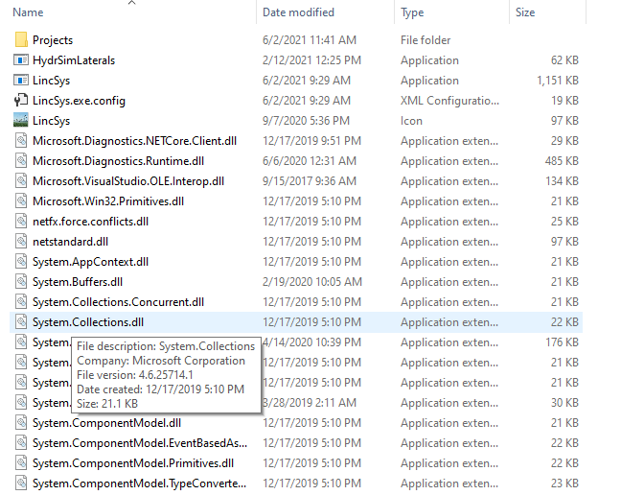
A quick exploration of the installation folder
The contents of the installation folder ^{(*)}
Opening the installation folder shows that a sizable number of files were copied into it during software installation, including
The executable files : HydrSimLaterals.exe and
LincSys.exe
The program configuration file, LincSys.exe.Config,
and the LincSys icon file, LincSys.Icon, and
A host of .Net Framework utility files with a *.dll (dynamic link library) extension and
A data folder named Projects
A limited view of the contents of the installation folder
^{(*)} Section 1.2.3.a and Chapter 5 of the user manual
Installation folder

Slide 59
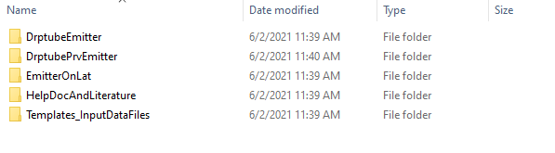
The system configuration options folders (consisting of the DroptubeEmitter, DroptubePrvEmitter,
and EmitterOnLateral folders) are
  Created during program installation under the Projects folder
  The DroptubeEmitter, DroptubePrvEmitter, and EmitterOnLateral folders are used to store
  LincSys project data corresponding to the Droptube-Emitter, Droptube-Prv-Emitter, and
  Emitter-On-Lateral system configuration options, respectively
  The contents of each of these folders will be discussed in the following slides
A quick exploration of the installation folder
The contents of the Projects folder ^{(*)}
The system configuration option folders are
DroptubeEmitter
DroptubePrvEmitter
EmitterOnLateral
Additional help document and data folders are
Contents of the Projects folder
  The HelpDocAndLiterature and the Templates_InputDataFiles folders are also created during installation
  The HelpDocAndLiterature folder stores documents that serve as resources to the help utility of LincSys
  and documents that contain a selected set of technical literature on lateral hydraulics and design and
  management. The contents of both types of documents can be accessed through the Help menu of
  LincSys
  The Templates_InputDataFiles folder contains input data file template, the contents and formats of which
  are used to create new LincSys projects
  The contents of each of these folders will be discussed in the following slides
There are five subfolders under
the Projects folder: three system
configuration options folders and
two additional document
and data folders
HelpDocAndLiterature
Templates_InputDataFiles
^{(*)} Sections 1.2.3.a and 5.1.1 to 5.1.3 of the user manual
The Projects folder

Slide 60
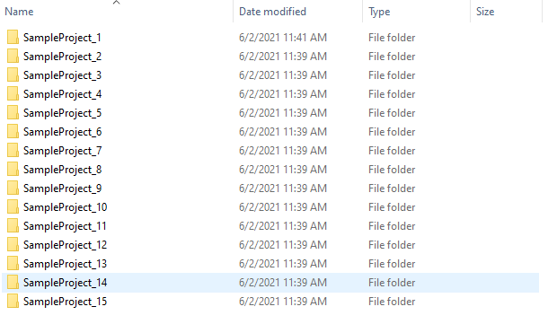
A quick exploration of the installation folder
Contents of the system configuration option folders at installation ^{(*)}
At installation, each of the system configuration option (i.e.,
DroptubeEmitter, DroptubePrvEmitter, and EmitterOnLateral)
folders contain 15 sample projects
Note: the names of the sample projects are the same for all
the three system configuration option folders, although
the contents are different
Contents of the system configuration option folders at installation
^{(*)} Section 5.1.1 of the user manual
System configuration option folder

Slide 61
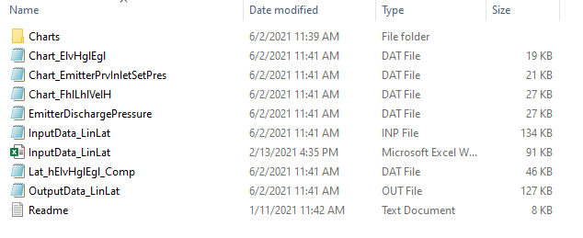
A quick exploration of the installation folder
Contents of a LincSys project folder are ^{(*)}
Input/output data files
A LincSys project folder contains seven input/output data files with
extensions Inp, Out, and Dat
  The file with the extension Inp (InputData_LinLat.Inp) is the
  input data file
  The files with the extension Out and Dat are the output data files
  (the main output data file being: OutputData_LinLat.Out)
  Note that all input/output data files are space delimited text files
Contents of a LincSys project folder
^{(*)} Section 5.1.1 of the user manual
LincSys project folder

Slide 62
A quick exploration of the installation folder
Contents of a LincSys project folder
Input/output data files
Additional files
A LincSys project folder contains two additional files with the extension Txt and Xlxs
  The file with the extension Txt is a readme file and is intended to serve as a
  quick reference resource on the contents of the current project folder
  The excel file (extension Xlxs) has the same content as the input data file
  (InputData_LinLat.Inp) and is intended to be used as an input data template
  that can be modified and adapted by the user as needed
Contents of a LincSys project folder
LincSys project folder

Slide 63
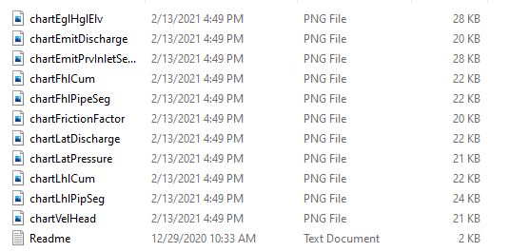
A quick exploration of the installation folder
Contents of a LincSys project folder
Input/output data files
Additional files
Charts subfolder
The Charts subfolder contains eleven files in Png format and a text file
Each Png file contains one of the eleven output charts of LincSys
The file with the extension Txt is a readme file and contains a
description of the contents of each file in the Charts folder
Contents of a Charts subfolder
LincSys project folder

Slide 64
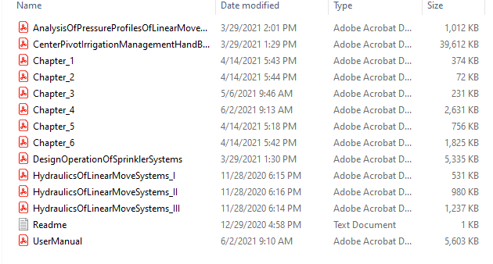
A quick exploration of the installation folder
Contents of the HelpDocAndLiterature folder ^{(*)}
The HelpDocAndLiterature folder contains thirteen documents in Pdf format and
a file with a Txt extension
  The Pdf files consist of two types of documents that can be accessed by the user
  through the Help menu of LincSys
    Files containing help information that will be displayed on the screen when
    relevant Help menu of LincSys is activated. This include the user manual
    (UserManual.Pdf) and a second set of documents, comprised of each
    chapter of the manual, intended for use as standalone help documents for quick
    reference on a specific topic (Chapter_1.Pdf, Chapter_2.Pdf, hapter_3.Pdf,
    Chapter_4.Pdf, Chapter_5.Pdf, and Chapter_6.Pdf),
    A selected set of technical literature on lateral hydraulics and system design and management in Pdf format, which can be displayed
    on the screen by activating a relevant Help menu item (AnalysisOfPressureProfilesOfLinearMoveLaterals.Pdf,
    HydraulicsOfLinearMoveSystems_I.Pdf, HydraulicsOfLinearMoveSystems_II.Pdf, HydraulicsOfLinearMoveSystems_III.Pdf,
    CenterPivotIrrigationManagementHandBook.Pdf, and DesignOperationOfSprinklerSystems.Pdf), and
                The Readme.Txt file contains a brief description of the contents of the folder
                Note: The documents in this folder MUST NOT be MOVED to another folder or ALTERED
                in any way.
-
Contents of the HelpDocAndLiterature folder
^{(*)} Section 1.2.3.a and Section 5.1.2 of the user manual
The HelpDocAndLiterature folder

Slide 65
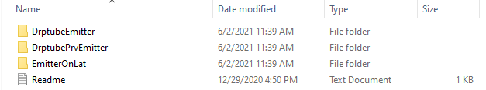
A quick exploration of the installation folder
Contents of the Template_InputDataFiles folder ^{(*)}
Contents of the Template_InputDatatFiles folder
The Template_InputDataFiles folder contains three subfolders
  DroptubeEmitter
  DroptubePrvEmitter
  EmitterOnLateral
Each of these folders contains LincSys input data files for laterals with number of spans ranging between six and twelve. The
contents and formats of these files are used by LincSys as templates for creating the input data file for a new project
Note that the DroptubeEmitter, DroptubePrvEmitter, and EmitterOnLateral folders contain input data template files for the
Droptube-Emitter, Droptube-Prv-Emitter, and Emitter-On-Lateral system configuration options, respectively
The Readme.txt file contains a brief description of the contents of the Template_InputDataFiles
^{(*)} Section 1.2.3.a and Section 5.1.3 of the user manual
The Template_InputDataFiles folder

Slide 66
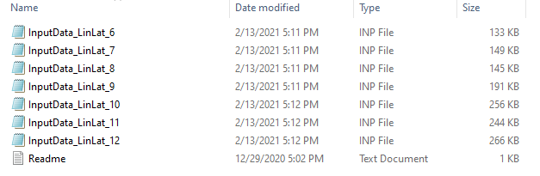
A quick exploration of the installation folder
Contents of any of the subfolders under Template_InputDataFiles folder ^{(*)}
Contents of the DroptubeEmitter, DroptubePrvEmitter, and EmitterOnLateral subfolders under the Template_InputDatatFiles folder
Each of the subfolders under the Template_InputDataFiles folder contains eight text files
    Files with the extension Inp are the input data template files
    The name of the input data template files consist of two parts: the basic input data file name (“InputData_LinLat”)
  and a string (“_6”, “_7”, “_8”, “_9”, “_10”, “_11” , and “_12”)
    These strings represent the number of spans, in the lateral, that a specific input data constitute
    The Readme.Txt file describes the contents of the Template_InputDataFiles folder
  Note: The input data template files MUST NOT be MOVED to ANOTHER FOLDER or ALTERED in any way!
^{(*)}Section 1.2.3.a and Section 5.1.3 of the user manual
The Template_InputDataFiles folder

Slide 67
A quick exploration of the installation folder
The contents and structure of LincSys’ project management, help information, and input data template files directory ^{(*)}
^{(*)} Section 5.1.1.a of the user manual
Structure of LincSys’ project management directory

Slide 68
Last Slide

